Slide 1

Symbolic Programming Paradigm

Slide 2
Introduction
Symbolic computation deals with the computation of mathematical objects symbolically. This means that the mathematical objects are represented exactly, not approximately, and mathematical expressions with unevaluated variables are left in symbolic form.
It Covers the following:
As A calculator and symbols
Algebraic Manipulations - Expand and Simplify
Calculus – Limits, Differentiation, Series , Integration
Equation Solving – Matrices

Slide 3
Calculator and Symbols
Rational - ½, or 5/2
>>import sympy as sym
>>a = sym.Rational(1, 2)
>>a Answer will be 1/2
Constants like pi,e
>>sym.pi**2 Answer is pi**2
>>sym.pi.evalf() Answer is 3.14159265358979
>> (sym.pi + sym.exp(1)).evalf() Answer is 5.85987448204884
X AND Y
>> x = sym.Symbol('x')
>>y = sym.Symbol('y')
>>x + y + x – y Answer is 2*x

Slide 4
Algebraic Manipulations
EXPAND ( X+Y)**3 = X+3X^2Y+3XY^2+Y
>> sym.expand((x + y) ** 3) Answer is x**3 + 3*x**2*y + 3*x*y**2 + y**3
>> 3 * x * y ** 2 + 3 * y * x ** 2 + x ** 3 + y ** 3 Answer is x**3 + 3*x**2*y + 3*x*y**2 + y**3
WITH TRIGNOMETRY LIKE SIN,COSINE
eg. COS(X+Y)= - SIN(X)*SIN(Y)+COS(X)*COS(Y)
>> sym.expand(sym.cos(x + y), trig=True) Answer is -sin(x)*sin(y) + cos(x)*cos(y)
SIMPLIFY
(X+X*Y/X)=Y+1
>>sym.simplify((x + x * y) / x) Answer is: y+1

Slide 5
Calculus
LIMITS compute the limit of
limit(function, variable, point)
limit( sin(x)/x , x, 0) =1
Differentiation
diff(func,var) eg diff(sin(x),x)=cos(x)
diff(func,var,n) eg
Series
series(expr,var)
series(cos(x),x) = 1-x/2+x/24+o(x)
Integration
Integrate(expr,var)
Integrate(sin(x),x) = -cos(x)

Slide 6
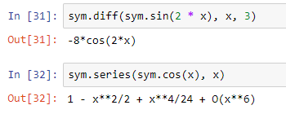
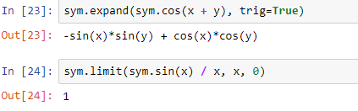
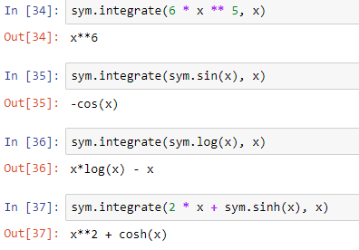
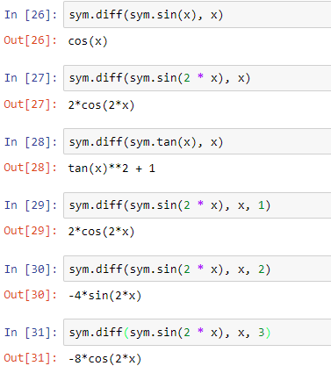
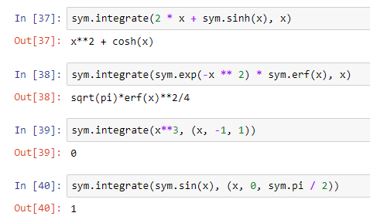
Example
Example:

Slide 7
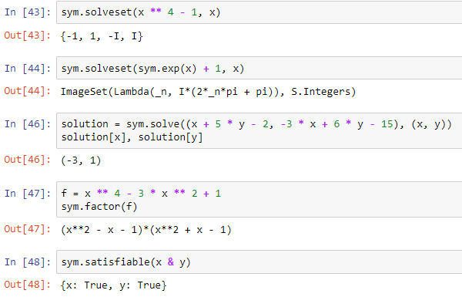
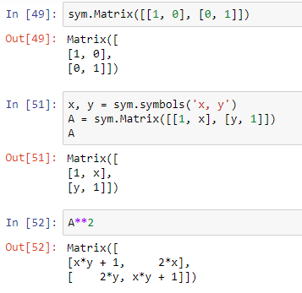
Example
Example:

Slide 8
Equation Solving
solveset()
solveset(x ** 4 - 1, x) ={-1,1,-I,I}
Matrices
A={[1,2][2,1]} find A**2

Slide 9
Application Areas of Sympy
Polynomials
Calculus
Discrete maths
Matrices
Geometry
Plotting
Physics
Statistics
Combinatorics

Slide 10
Equation Solving
solveset()
solveset(x ** 4 - 1, x) ={-1,1,-I,I}
Matrices
A={[1,2][2,1]} find A**2

Slide 11
Automata Based Programming Paradigm

Slide 12
Introduction
Automata-based programming is a programming paradigm in which the program or its part is thought of as a model of a finite state machine or any other formal automation.
What is Automata Theory?
Automata theory is the study of abstract computational devices
Abstract devices are (simplified) models of real computations
Computations happen everywhere: On your laptop, on your cell phone, in nature, …
Example:
input: switch
output: light bulb
actions: flip switch
states: on, off
BATTERY

Slide 13
Simple Computer
Example:
input: switch
output: light bulb
actions: flip switch
states: on, off
bulb is on if and only if there was an odd number of flips
BATTERY
f
start
off
on
f

Slide 14
Another “computer”
Example:
inputs: switches 1 and 2
actions: 1 for “flip switch 1”
actions: 2 for “flip switch 2”
states: on, off
bulb is on if and only if both switches were flipped an odd number of times
1
BATTERY
2
start
off
off
1
2
2
2
2
1
off
on
1

Slide 15
Types of Automata
finite automata | Devices with a finite amount of memory. Used to model “small” computers.
push-down automata | Devices with infinite memory that can be accessed in a restricted way. Used to model parsers, etc.
Turing Machines | Devices with infinite memory. Used to model any computer.

Slide 16
Alphabets and strings
A common way to talk about words, number, pairs of words, etc. is by representing them as strings
To define strings, we start with an alphabet
Examples:
An alphabet is a finite set of symbols.
Σ₁ = {a, b, c, d, …, z}: the set of letters in English
Σ₂ = {0, 1, …, 9}: the set of (base 10) digits
Σ₃ = {a, b, …, z, #}: the set of letters plus the special symbol #
Σ₄ = {(, )}: the set of open and closed brackets

Slide 17
Strings
The empty string will be denoted by e
Examples:
A string over alphabet Σ is a finite sequence of symbols in Σ.
abfbz is a string over Σ₁ = {a, b, c, d, …, z}
9021 is a string over Σ₂ = {0, 1, …, 9}
ab#bc is a string over Σ₃ = {a, b, …, z, #}
))()(() is a string over Σ₄ = {(, )}

Slide 18
Languages
Languages can be used to describe problems with “yes/no” answers, for example:
A language is a set of strings over an alphabet.
L₁ = The set of all strings over Σ₁ that contain the substring “SRM”
L₂ = The set of all strings over Σ₂ that are divisible by 7 = {7, 14, 21, …}
L₃ = The set of all strings of the form s#s where s is any string over {a, b, …, z}
L₄ = The set of all strings over Σ₄ where every ( can be matched with a subsequent )

Slide 19
Finite Automata
There are states off and on, the automaton starts in off and tries to reach the “good state” on
What sequences of fs lead to the good state?
Answer: {f, fff, fffff, …} = {f n: n is odd}
This is an example of a deterministic finite automaton over alphabet {f}
f
off
on
f

Slide 20
Deterministic finite automata
DFA refers to deterministic finite automata. The finite automata are called deterministic finite automata if the machine is read an input string one symbol at a time.
In DFA, there is only one path for specific input from the current state to the next state.
DFA does not accept the null move, i.e., the DFA cannot change state without any input character.
DFA can contain multiple final states.

Slide 21
Deterministic finite automata
A deterministic finite automaton (DFA) is a 5-tuple (Q, Σ, δ, q₀, F) where
Q is a finite set of states
Σ is an alphabet
δ: Q × Σ → Q is a transition function
q₀ ∈ Q is the initial state
F ⊆ Q is a set of accepting states (or final states).
In diagrams, the accepting states will be denoted by double loops

Slide 22
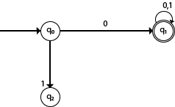

Example
DFA with ∑ = {0, 1} accepts all starting with 0.
Solution:
DFA with ∑ = {0, 1} accepts all ending with 0.
Solution:

Slide 23
Example
0
1
0,1
q₀
1
q₁
0
q₂
transition function δ:
inputs
0
1
alphabet Σ = {0, 1}
start state Q = {q₀, q₁, q₂}
initial state q₀
accepting states F = {q₀, q₁}
q₀
q₀
q₁
states
q₁
q₂
q₁
q₂
q₂
q₂

Slide 24
Language of a DFA
The language of a DFA (Q, Σ, δ, q₀, F) is the set of all strings over Σ that, starting from q₀ and following the transitions as the string is read left to right, will reach some accepting state.
f
M:
off
on
f
Language of M is {f, fff, fffff, …} = {f ^{n}: n is odd}

Slide 25
Example of DFA
1. Let Σ = {0, 1}. Give DFAs for {}, {ε}, Σ*, and Σ⁺.
For {}: For {ε}:
For Σ*: For Σ⁺:
0/1
0/1
q₀
0/1
q₁
q₀
0/1
0/1
q₀
0/1
q₁
q₀

Slide 26
Example of DFA
q₀
0,1
L(M) =
{0,1}*
0
0
1
q₀
q₁
1
L(M) =
{ w | w has an even number of 1s}

Slide 27
Example of DFA
Build an automaton that accepts all and only those strings that contain 001
0,1
1
0
0
0
1
q
q₀
q₀₀
q₀₀₁
1

Slide 28
Example of DFA using Python
from automata.fa.dfa import DFA
# DFA which matches all binary strings ending in an odd number of '1's
dfa = DFA(
states={'q0', 'q1', 'q2'},
input_symbols={'0', '1'},
transitions={
'q0': {'0': 'q0', '1': 'q1'},
'q1': {'0': 'q0', '1': 'q2'},
'q2': {'0': 'q2', '1': 'q1'}
},
initial_state='q0',
final_states={'q1'}
)
dfa.read_input('01') # answer is 'q1‘
dfa.read_input('011') # answer is error
print(dfa.read_input_stepwise('011'))
Answer # yields:
# 'q0‘ # 'q0‘ # 'q1'
# 'q2‘ # 'q1'
if dfa.accepts_input('011'):
print('accepted')
else:
print('rejected')

Slide 29
Questions for DFA
Find an DFA for each of the following languages over the alphabet {a, b}.
(a) {(ab)^{n} | n ∈ N}, which has regular expression (ab)*.
Solution:
b
a
a
(a):
Start
b
a, b
b) Find a DFA for the language of a + aa*b.
Solution:
a
a
a
1
2
Start
0
b
b
b
4
3
a, b
a, b

Slide 30
Questions for DFA
c) A DFA that accepts all strings that contain 010 or do not contain 0.
1
0
0, 1
0
1
0
1
0
1

Slide 31
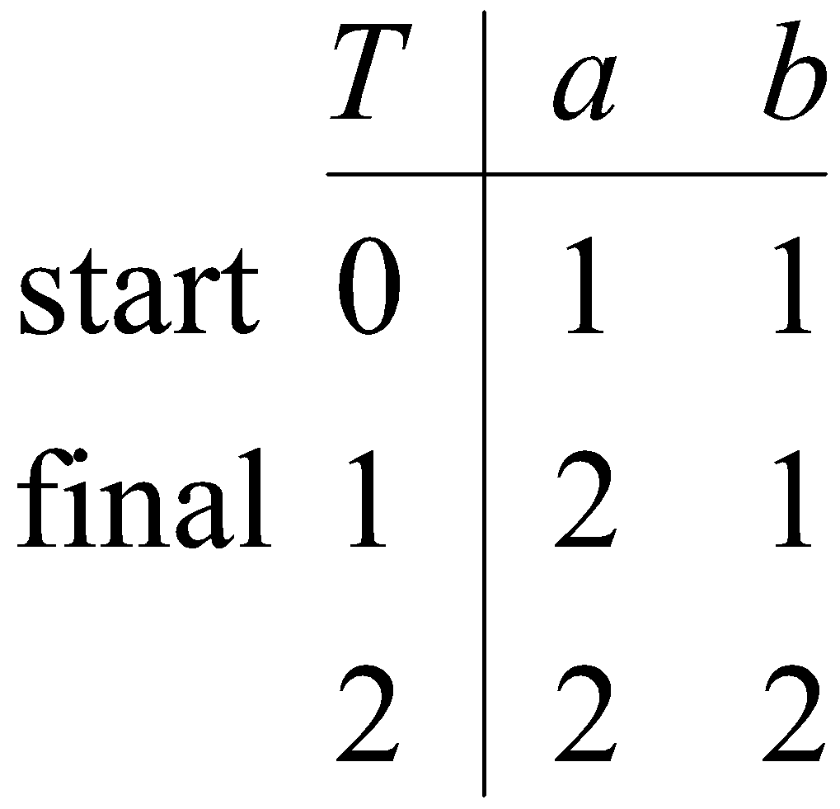
Table Representation of a DFA
A DFA over A can be represented by a transition function T : States X A -> States, where T(i, a) is the state reached from state i along the edge labelled a, and we mark the start and final states. For example, the following figures show a DFA and its transition table.
b
a, b
1
Start
0
a
2
a, b

Slide 32
Sample Exercises - DFA
Write a automata code for the Language that accepts all and only those strings that contain 001
Write a automata code for L(M) ={ w | w has an even number of 1s}
Write a automata code for L(M) ={0,1}*
Write a automata code for L(M)=a + aa*b.
Write a automata code for L(M)={(ab)^{n} | n ∈ N}
Write a automata code for Let Σ = {0, 1}.
Given DFAs for {}, {ε}, Σ*, and Σ⁺.

Slide 33
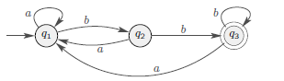
NDFA
In any DFA, the next state the machine goes to on any given symbol is uniquely determined. This is why these machines are deterministic.
Nondeterministic finite automata (NFAs) allow for several or no choices to exist for the next state on a given symbol
Remember that the transition function in a DFA is defined as
δ : Q × Σ → Q.
Because range of δ is Q, fcn δ always returns a single state.
DFA has exactly one transition leaving each state for each symbol.
δ(q, λ) tells what state the edge out of q labeled with λ leads to.

Slide 34
NDFA
For a state q and symbol λ ∈ Σ, NFA can have
multiple edges leaving q labelled with the same symbol λ
no edge leaving q labelled with symbol λ
edges leaving q labelled with ε
can take ε-edge without reading any symbol from input string.
Suppose NFA is in a state with multiple ways to proceed, e.g., in state q1 and the next symbol in input string is 1. NFA may be in a set of states, instead of a single state.

Slide 35
NDFA
A nondeterministic finite automaton M is a five-tuple M = (Q, Σ, δ, q₀, F), where:
Q is a finite set of states of M
Σ is the finite input alphabet of M
δ: Q × Σ → power set of Q, is the state transition function mapping a state-symbol pair to a subset of Q
q₀ is the start state of M
F ⊆ Q is the set of accepting states or final states of M

Slide 36
NFA Differs over DFA
Transition of ∈ (null) or lambda is allowed in NFA
NFA on reading one input it can transition to two different states
Dead configuration is possible in NFA (Its not necessary to consider all input for transition)

Slide 37
Example NDFA
NFA that recognizes the language of strings that end in 01
0,1
0
q₁
1
q₂
q₀
Exercise: Draw the complete transition table for this NFA
note: δ(q₀,0) = {q₀,q₁} δ(q₁,0) = {}

Slide 38
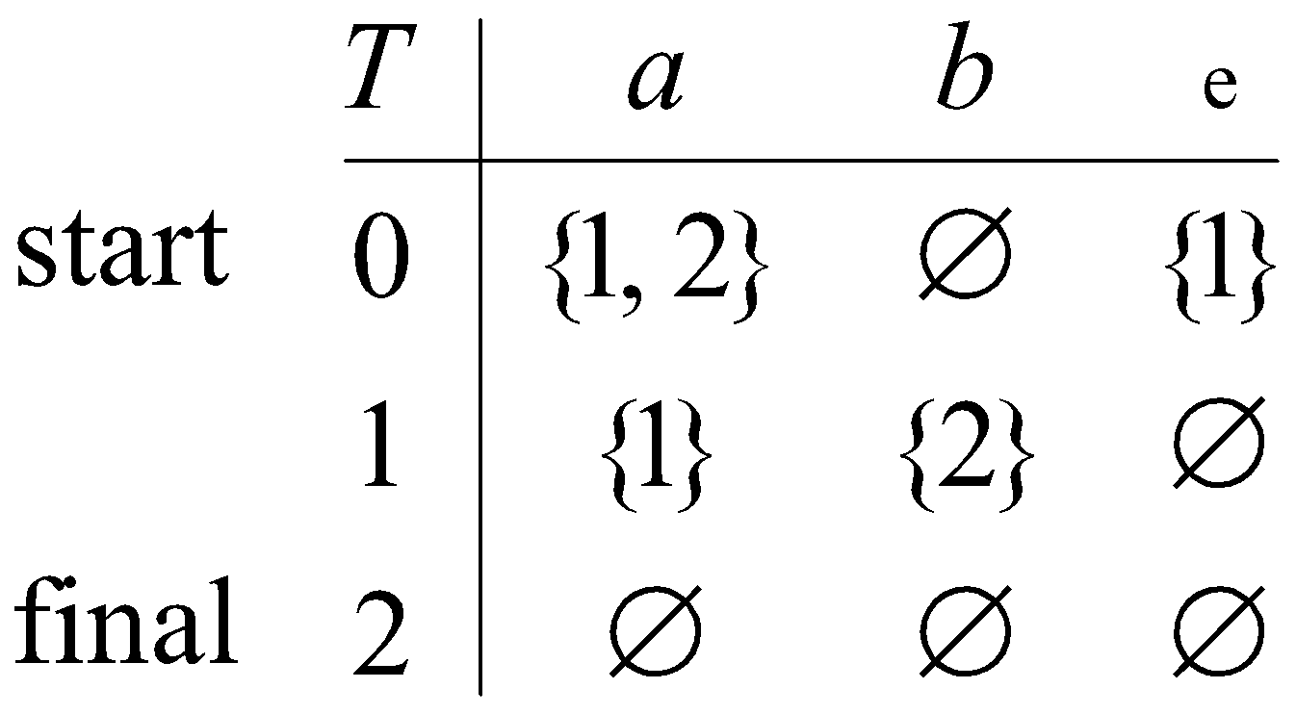
NDFA
A nondeterministic finite automaton (NFA) over an alphabet A is similar to a DFA except that epislon-edges are allowed, there is no requirement to emit edges from a state, and multiple edges with the same letter can be emitted from a state.
Example. The following NFA recognizes the language of a + aa*b + a*b.
Table representation of NFA
An NFA over A can be represented by a function T : States × A ∪ {L} → power(States), where T(i, a) is the set of states reached from state i along the edge labeled a, and we mark the start and final states. The following figure shows the table for the preceding NFA.
1
a
ɛ
a
b
a
2
Start
0

Slide 39
Examples
Solutions: (a):
Start
(b):
Start
b
(c):
Start
a
Find an NFA to recognize the language (a + ba)*bb(a + ab)*.
A solution:
a
a
Start
b
b
b
a
a
b

Slide 40
Examples
Algorithm: Transform a Regular Expression into a Finite Automaton
Start by placing the regular expression on the edge between a start and final state:
Regular expression
Start
Apply the following rules to obtain a finite automaton after erasing any ∅-edges.
R
i
R + S
j
transforms to
i
S
j
i
RS
R
S
j
transforms to
i
j
R
R*
ɛ
ɛ
i
j
transforms to
i
j
Quiz. Use the algorithm to construct a finite automaton for (ab)* + ba.
Answer:
b
a
Start
ɛ
ɛ
b
a

Slide 41
Example of NFA using Python
from automata.fa.nfa import NFA
# NFA which matches strings beginning with 'a', ending with 'a', and containing
# no consecutive 'b's
nfa = NFA(
states={'q0', 'q1', 'q2'},
input_symbols={'a', 'b'},
transitions={
'q0': {'a': {'q1'}},
# Use '' as the key name for empty string (lambda/epsilon) transitions
'q1': {'a': {'q1'}, '': {'q2'}},
'q2': {'b': {'q0'}}
},
initial_state='q0',
final_states={'q1'}
)
nfa.read_input('aba')
ANSWER :{'q1', 'q2'}
nfa.read_input('abba')
ANSWER: ERROR
nfa.read_input_stepwise('aba')
if nfa.accepts_input('aba'):
print('accepted')
else:
print('rejected')
ANSWER: ACCEPTED
nfa.validate()
ANSWR: TRUE

Slide 42
Algorithm: Transform a Regular Expression into a Finite Automaton
Start by placing the regular expression on the edge between a start and final state:
Regular expression
Start
Apply the following rules to obtain a finite automaton after erasing any ∅-edges.
R
i
R + S
j
transforms to
i
S
j
i
RS
R
S
j
transforms to
i
j
R
R*
ɛ
ɛ
i
j
transforms to
i
j
Quiz. Use the algorithm to construct a finite automaton for (ab)* + ba.
Answer:
b
a
Start
ɛ
ɛ
b
a
42
Notes:
42

Slide 43
Example of NFA using Python
from automata.fa.nfa import NFA
# NFA which matches strings beginning with 'a', ending with 'a', and containing no consecutive 'b's
nfa = NFA(
states={'q0', 'q1', 'q2'},
input_symbols={'a', 'b'},
transitions={
'q0': {'a': {'q1'}},
# Use '' as the key name for empty string (lambda/epsilon) transitions
'q1': {'a': {'q1'}, '': {'q2'}},
'q2': {'b': {'q0'}}
},
initial_state='q0',
final_states={'q1'}
)
nfa.read_input('aba')
ANSWER :{'q1', 'q2'}
nfa.read_input('abba')
ANSWER: ERROR
nfa.read_input_stepwise('aba')
if nfa.accepts_input('aba'):
print('accepted')
else:
print('rejected')
ANSWER: ACCEPTED
nfa.validate()
ANSWR: TRUE

Slide 44
Sample Exercises - NFA
Write a automata code for the Language that accepts all end with 01
Write a automata code for L(M)= a + aa*b + a*b.
Write a automata code for Let Σ = {0, 1}.
Given NFAs for {}, {ε}, {(ab)^{n} | n ∈ N}, which has regular expression (ab)*.

